Slide 1

3. Initial settings Server Core
Windows Server 2019 Basics

Slide 2
Steps
Set networking settings
Change computer name
Configure Firewall rules
Enable Remote Desktop
Set Time Zone

Slide 3
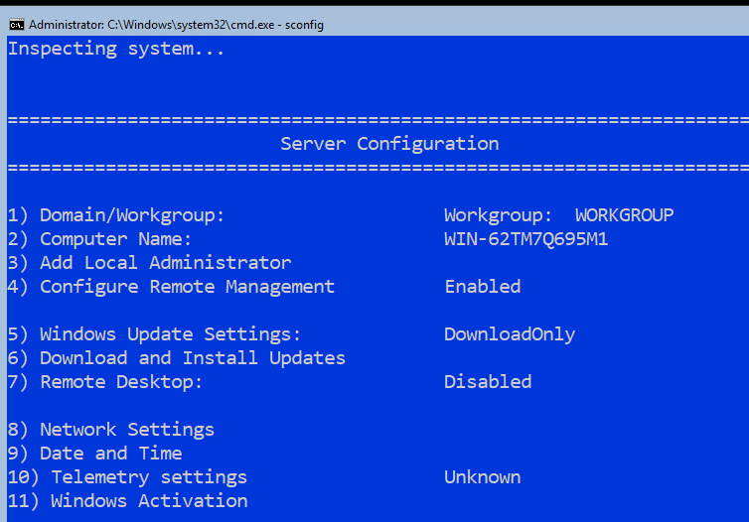
Set networking settings
Notes:
Type sconfig in the CMD window to open the server core configuration utility.

Slide 4
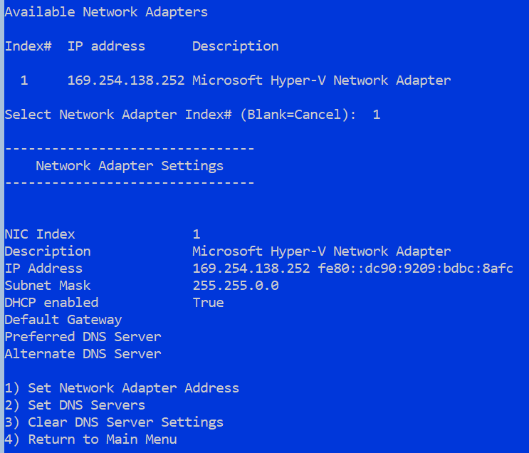
Set networking settings
Notes:
Type 8 to go to the Network Settings. After that you will see a list of network adapters along with their index numbers. Just type the index of the adapter you want to configure.

Slide 5
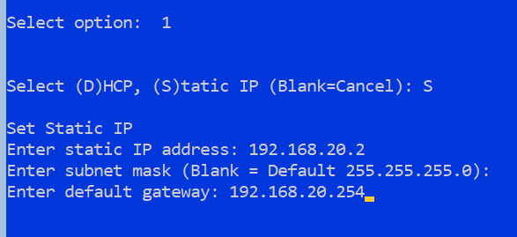
Set networking settings
Notes:
You will be asked if you want to configure the adapter with static settings or with DHCP. Press S for static and then enter the IP,mask and gateway.

Slide 6
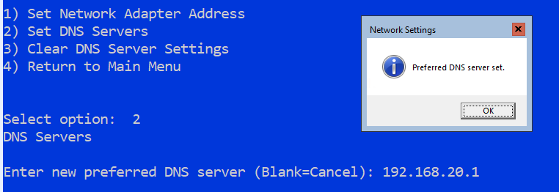
Set networking settings
Notes:
In order to set the DNS just press 2 and enter the primary DNS address. After that you can also enter a secondary address. Press 4 to return to the main menu.

Slide 7
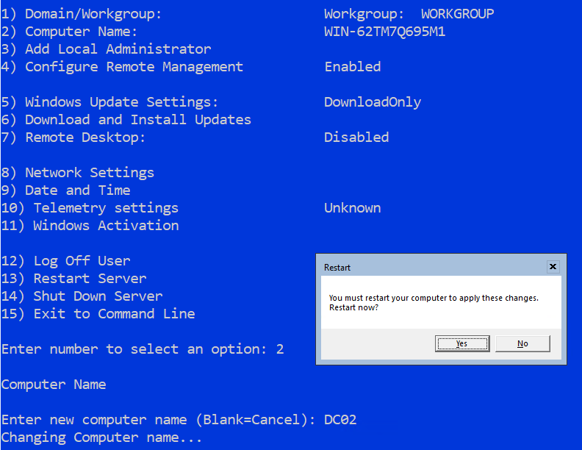
Change computer name
Notes:
To change the computer name just press 2 in the sconfig tool and enter the new name. The server must be restarted in order for the new name to be applied.

Slide 8
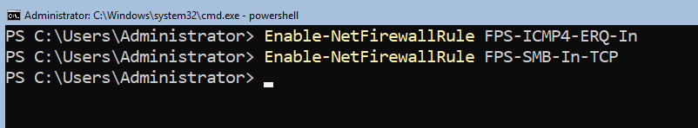
Configure Firewall rules
Notes:
The 2 inbound rules that I always configure are:
- File and Printer Sharing (Echo Request – ICMPv4-In) This is the rule that enables Ping
- File and Printer Sharing (SMB-In) This rule enables file sharing
On the CMD windows type: powershell
Enable the 2 rules by running the following CmdLets:
Enable-NetFirewallRule FPS-ICMP4-ERQ-In
Enable-NetFirewallRule FPS-SMB-In-TCP

Slide 9
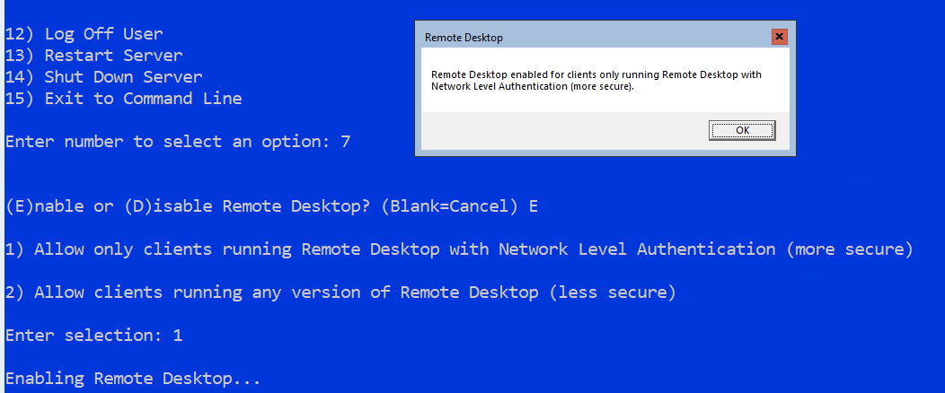
Enable Remote Desktop
Notes:
The Remote Desktop (although not very useful on server core) can be enabled from sconfig. Type 7, then press E to enable and press 1.

Slide 10
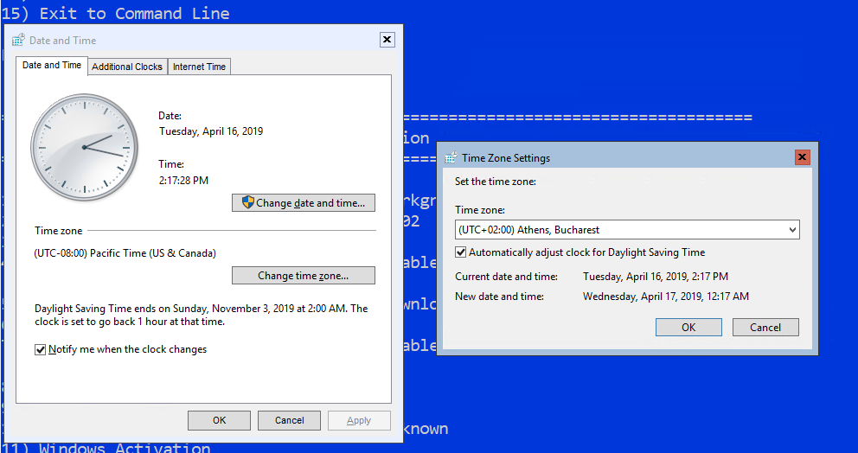
Set Time Zone
Notes:
Press 9 to open the Date and Time settings. Click Change time zone and select your location’s time settings.

Slide 11
https://www.youtube.com/channel/UCcZ-jLbPwNr8E_v9-65n8Iw https://github.com/itknowledge4

